Slide 1
Discrete Structures for Computer Science
(CS F222)
Topic: Spanning Tress
Dr. Raghunath Reddy

Slide 2
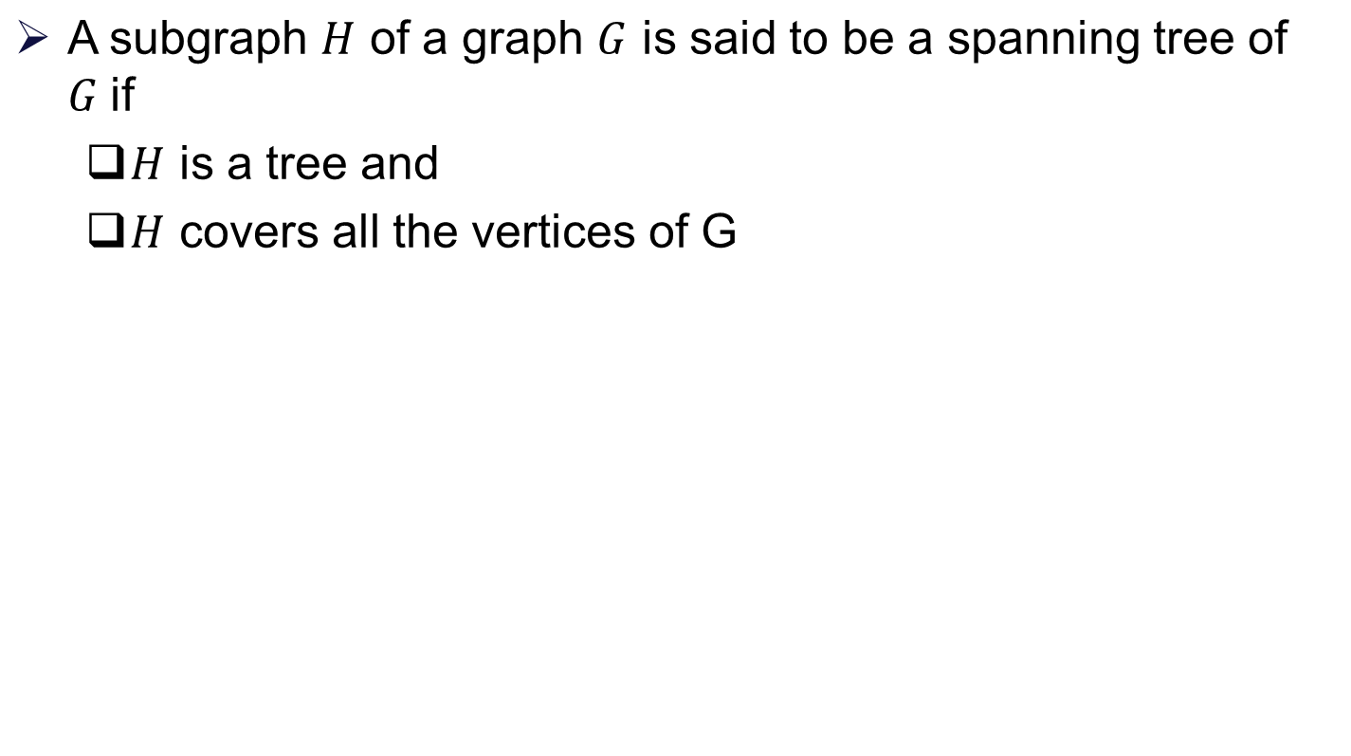
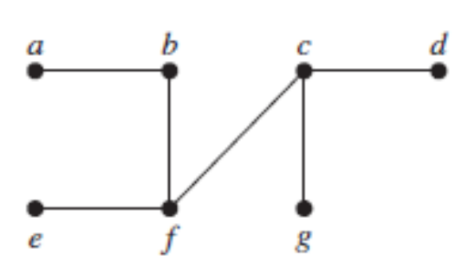
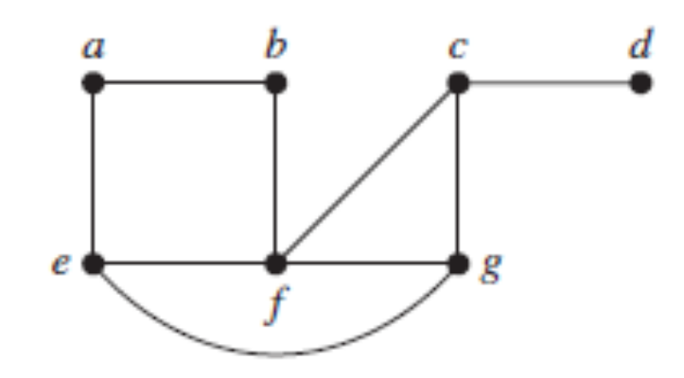
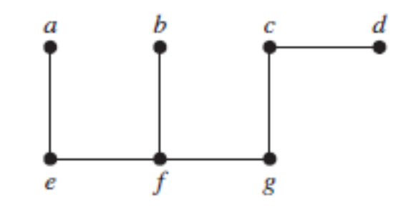
Spanning tree

Slide 3
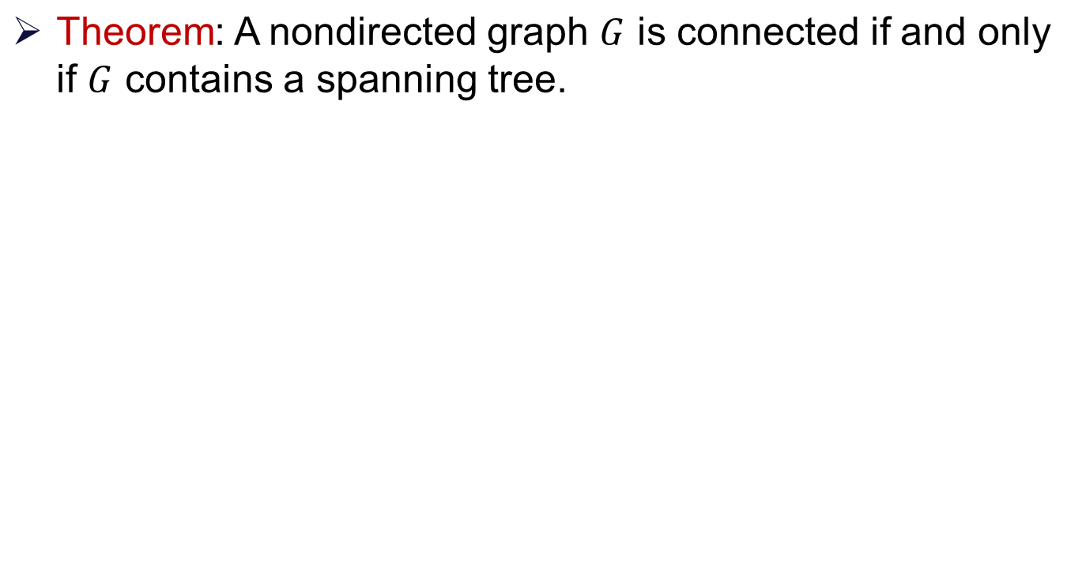
Spanning tree

Slide 4
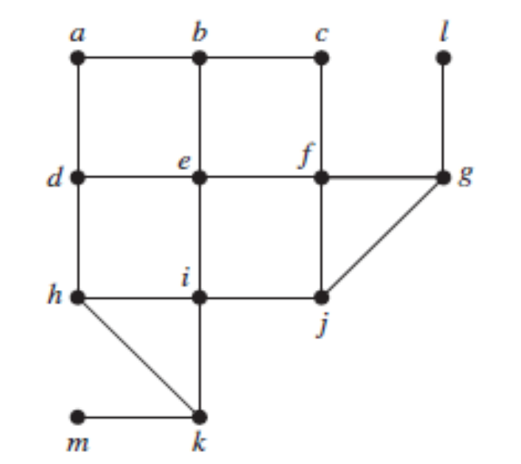
Breadth-first search (BFS)

Slide 5
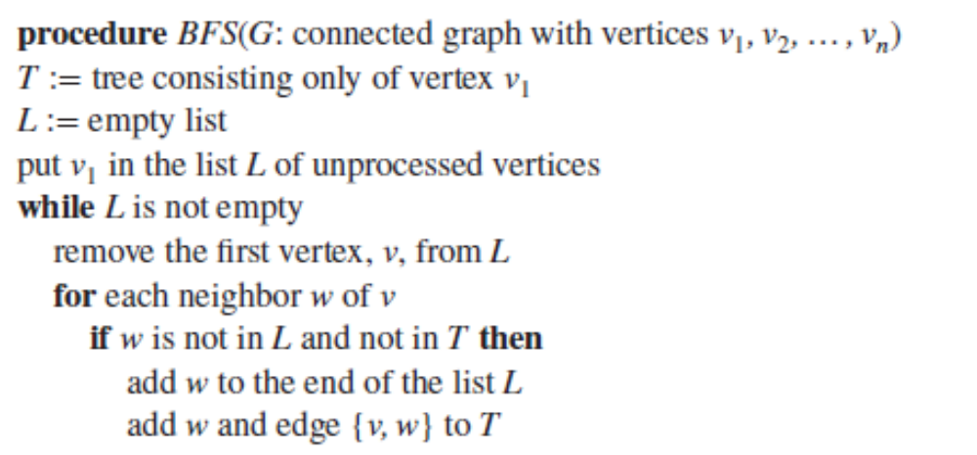
Breadth-first search (BFS)

Slide 6
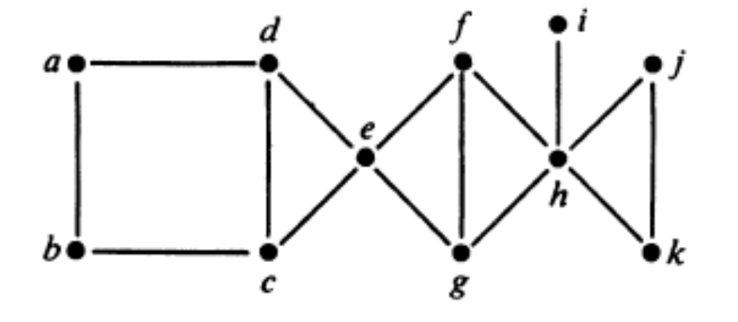
Depth-first search (DFS)

Slide 7
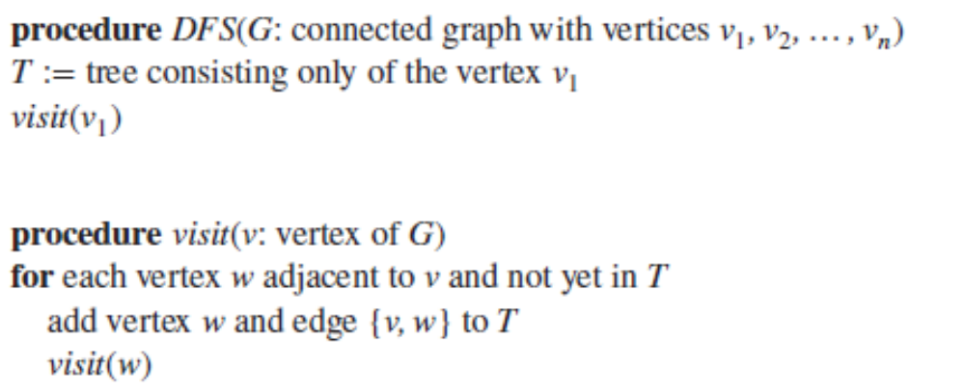
Depth-first search (DFS)

Slide 8
Other uses of BFS and DFS algorithms
Connectedness of a graph
Cycles in a graph

Slide 9
Minimum Spanning Trees

Slide 10
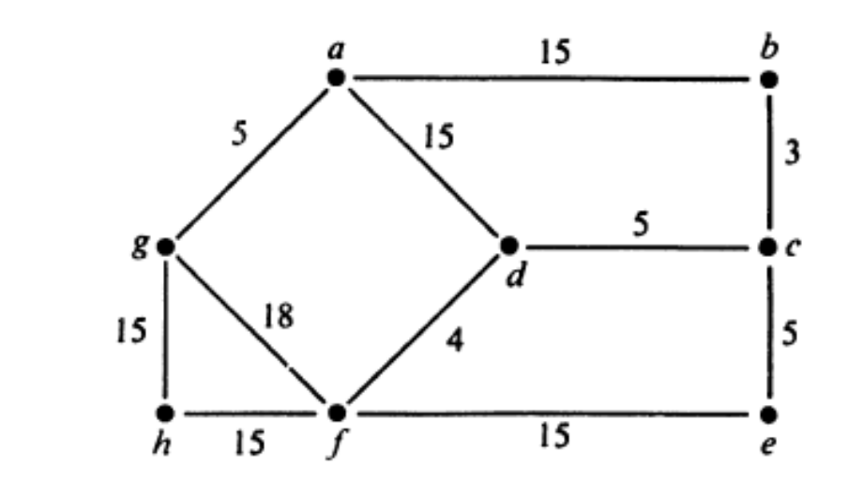
Minimum spanning tree
Weighted graph:

Slide 11
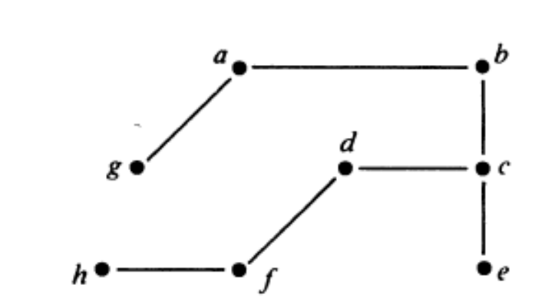
Minimum spanning tree
A minimum spanning tree in a connected weighted graph is a spanning tree that has the smallest possible sum of weights of its edges.
        Cost = 52

Slide 12
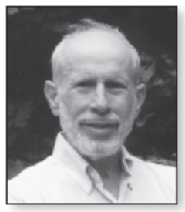
Kruskal’s algorithm for MST

Slide 13
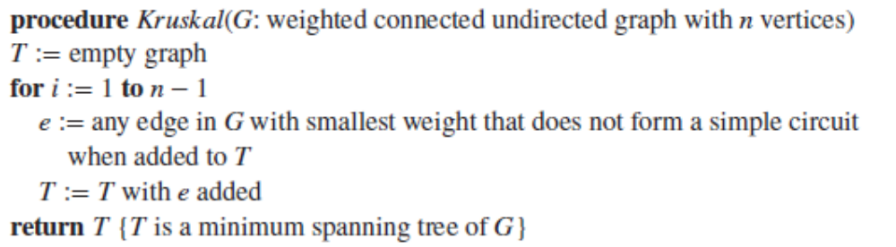
Kruskal’s algorithm for MST

Slide 14
Kruskal’s algorithm for MST
Correctness of Kruskal’s algorithm

Slide 15
Kruskal’s algorithm for MST
Correctness of Kruskal’s algorithm

Slide 16
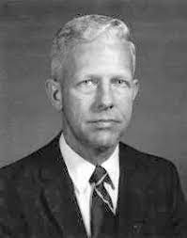
Prim’s algorithm for MST

Slide 17
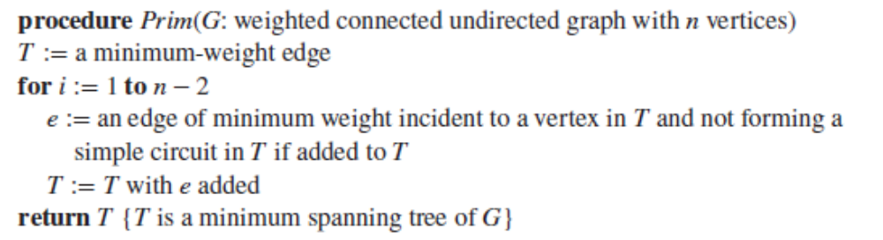
Prim’s algorithm for MST

Slide 18
Multigraphs and Euler Circuits

Slide 19
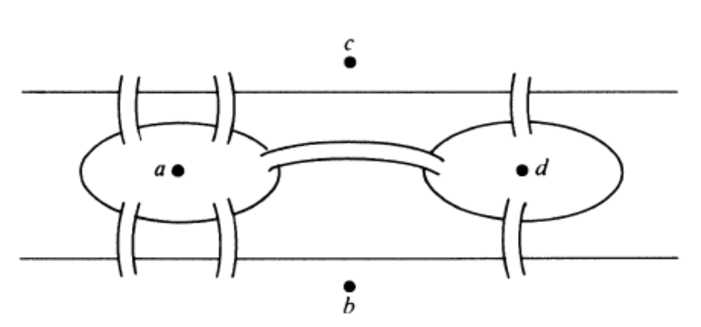
Konigsberg bridges problem
Bridges of Konigsberg (today’s Kaliningrad): walk all 7 bridges without crossing a bridge twice.

Slide 20
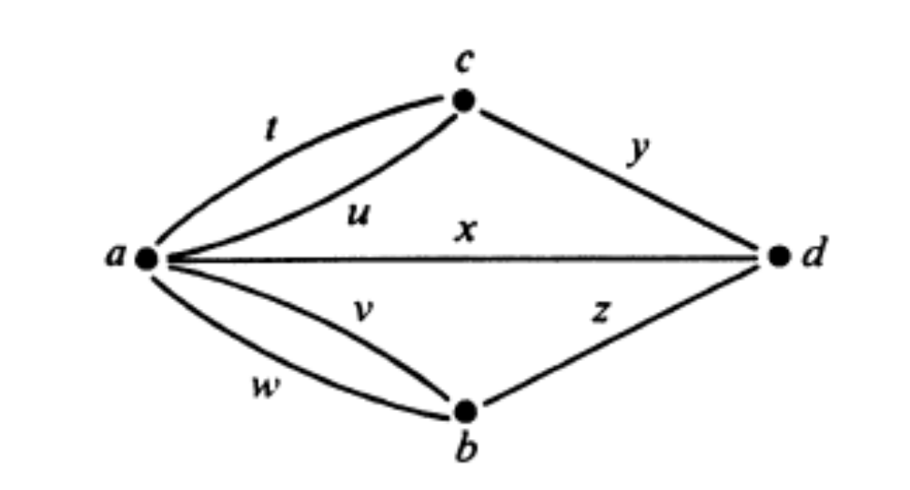
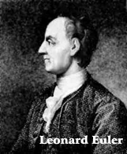
Multigraph model
        In year 1736

Slide 21
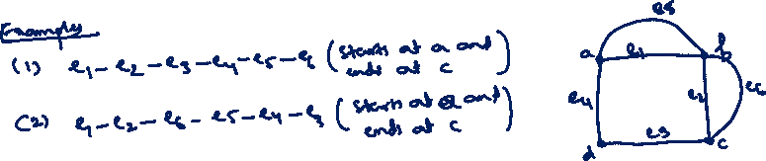
Euler path
An Euler path in a multigraph is a path that
  includes each edge of the multigraph exactly once and
  contains each vertex of the multigraph at least once.

Slide 22
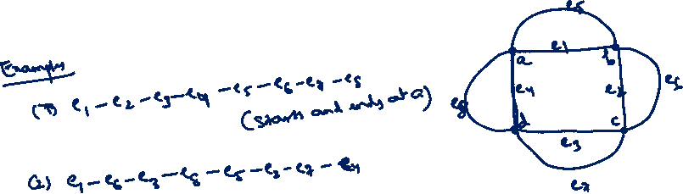
Euler circuit
An Euler circuit in is a Euler path whose end points are identical.
A multigraph is said to be an Eulerian multigraph if it has a Euler circuit

Slide 23
Existence of Euler path

Slide 24
Existence of Euler path
Theorem: A nondirected multigraph has a Euler path iff it is connected and has 0 or exactly 2 vertices of odd degrees.

Slide 25
Existence of Euler circuit
Corollary: A nondirected multigraph has a Euler circuit iff it is connected and all of its vertices are of even degree.

Slide 26
Solution for Konigsberg bridges problem

Slide 27
Thank You!!

